Slide 1




Notes:
*

Slide 2


UI ENGINEERING STUDIO
UI Engineering Studio. Day 5 Bootcamp:
Javascript Events

Slide 3
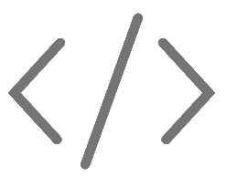
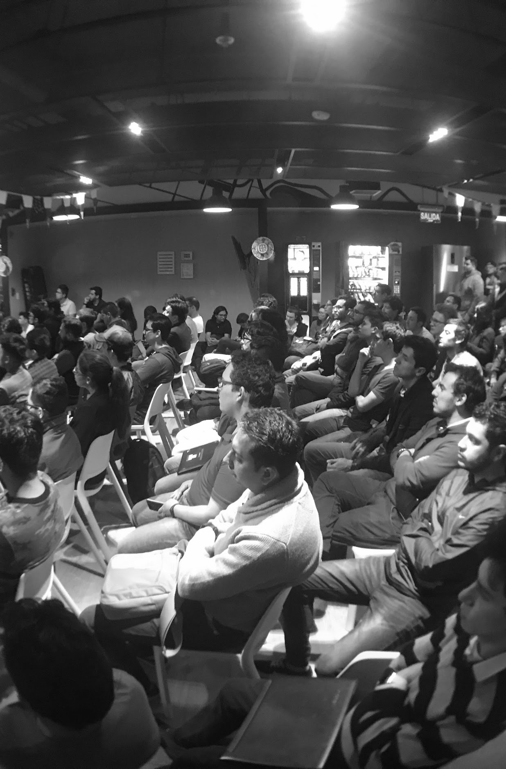
UI ENGINEERING STUDIO
Events
Event-driven programming is a programming paradigm in which the flow of the program is determined by events such as user actions (mouse clicks, key presses), sensor outputs, or messages from other programs/threads.
- Wikipedia
Event Type
Commons Events
Event Handler

Slide 4
UI ENGINEERING STUDIO
UI Boot Camp: JS Javascript Events
Inline Event Handler
Everything starts by following an event.
<button onclick="document.getElementById('demo')
.innerHTML = Date()">The time is?</button>
HTML events are "things" that happen to HTML elements.
web page has finished loading
input field was changed
button was clicked
DOM Events are sent to notify code of interesting things that have taken place. -Mozilla
IDom Event Handler
window.addEventListener('load', () => { //window loaded })

Slide 5
UI ENGINEERING STUDIO
UI Boot Camp: JS Some Common Events
Everything starts by following an event.
document.getElementById("myBtn").addEventListener("click", function(){ document.getElementById("demo").innerHTML = "Hello World"; });
onchange
onclick
onmouseout
onkeydown
onload

Slide 6
UI ENGINEERING STUDIO
UI Boot Camp: JS EVENT HANDLERS
const xhr = new XMLHttpRequest() xhr.onreadystatechange = () => { //.. do something }
You can respond to any event using an Event Handler, which is just a function that’s called when an event occurs.
You can register multiple handlers for the same event, and they will all be called when that event happens.
You can listen on window to intercept “global” events, like the usage of the keyboard, and you can listen on specific elements to check events happening on them, like a mouse click on a button.
document.getElementById("myBtn").addEventListener("click", function(){ document.getElementById("demo").innerHTML = "Hello World"; });
window.addEventListener('load', () => { //window loaded })

Slide 7
Notes:
*

